Slide 1

MATH30
Probability and Statistics

Slide 2

Measures of Location
Sample mean
$$\overline{x}=\sum_{i=1}^{n}{\frac{x_{i}}{n}}=\frac{x_{1}+x_{2}+…+x_{n}}{n}$$
Sample median
$\tilde{x}=x_{{\left(n+1\right)}/2}$ if n is odd,
$\tilde{x}=\frac{x_{n/2}+x_{n/2+1}}{2}$ if n is even.

Slide 3
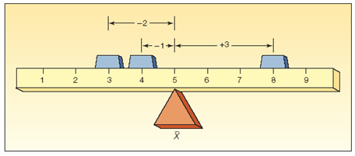
Characteristics of the Mean
The arithmetic mean is the most widely used measure of location. It requires the interval scale. Its major characteristics are:
All values are used.
It is unique.
The sum of the deviations from the mean is 0.
It is calculated by summing the values and dividing by the number of values.

Slide 4
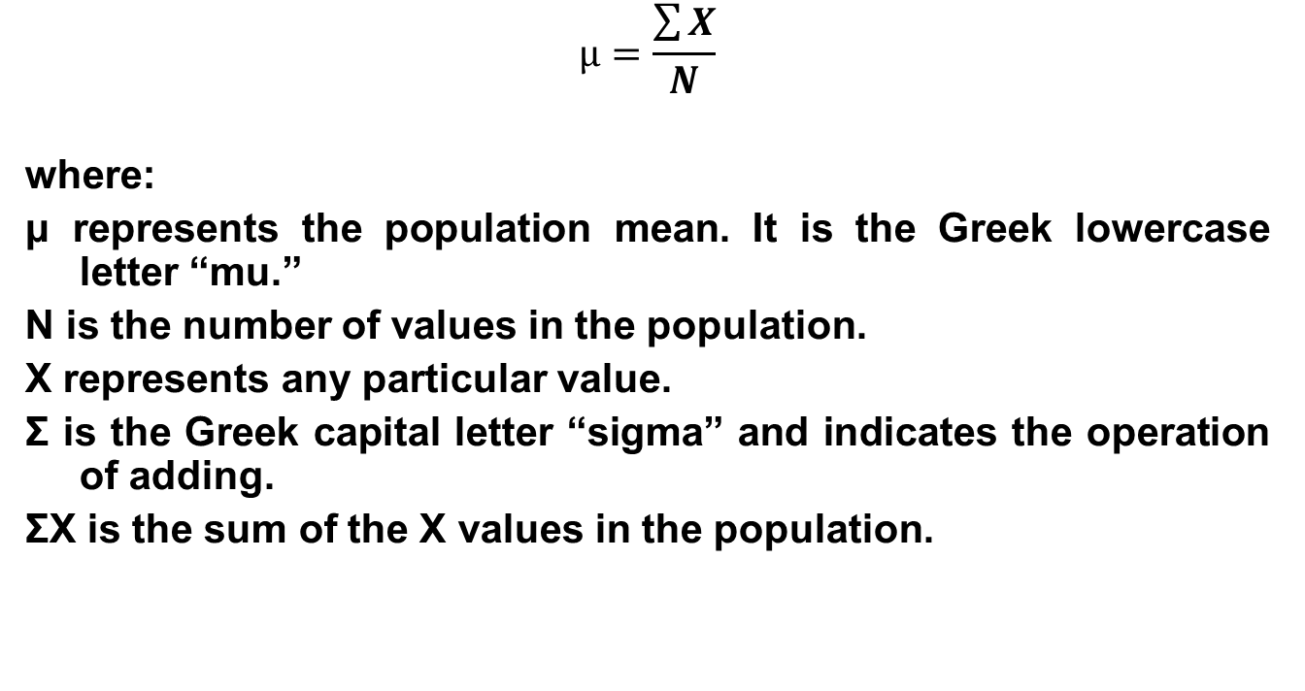
Population Mean
$$μ=\frac{\sum{X}}{N}$$
where:
μ represents the population mean. It is the Greek lowercase letter “mu.”
N is the number of values in the population.
X represents any particular value.
Σ is the Greek capital letter “sigma” and indicates the operation of adding.
ΣX is the sum of the X values in the population.

Slide 5
Properties of the Arithmetic mean
Every set of interval-level and ratio-level data has a mean.
All the values are included in computing the mean.
A set of data has a unique mean.
The mean is affected by unusually large or small data values.
The arithmetic mean is the only measure of central tendency where the sum of the deviations of each value from the mean is zero.

Slide 6

Weighted Mean
The weighted mean of a set of numbers x₁, x₂,…, x_{n}, with corresponding weights w₁, w₂,…,w_{n}, is computed from the following formula:
$${\overline{X}}_{w}=\frac{w_{1}x_{1}+w_{2}x_{2}+w_{3}x_{3}…{+w}_{n}x_{n}}{w_{1}+w_{2}+w_{3}+…+w_{n}}$$

Slide 7
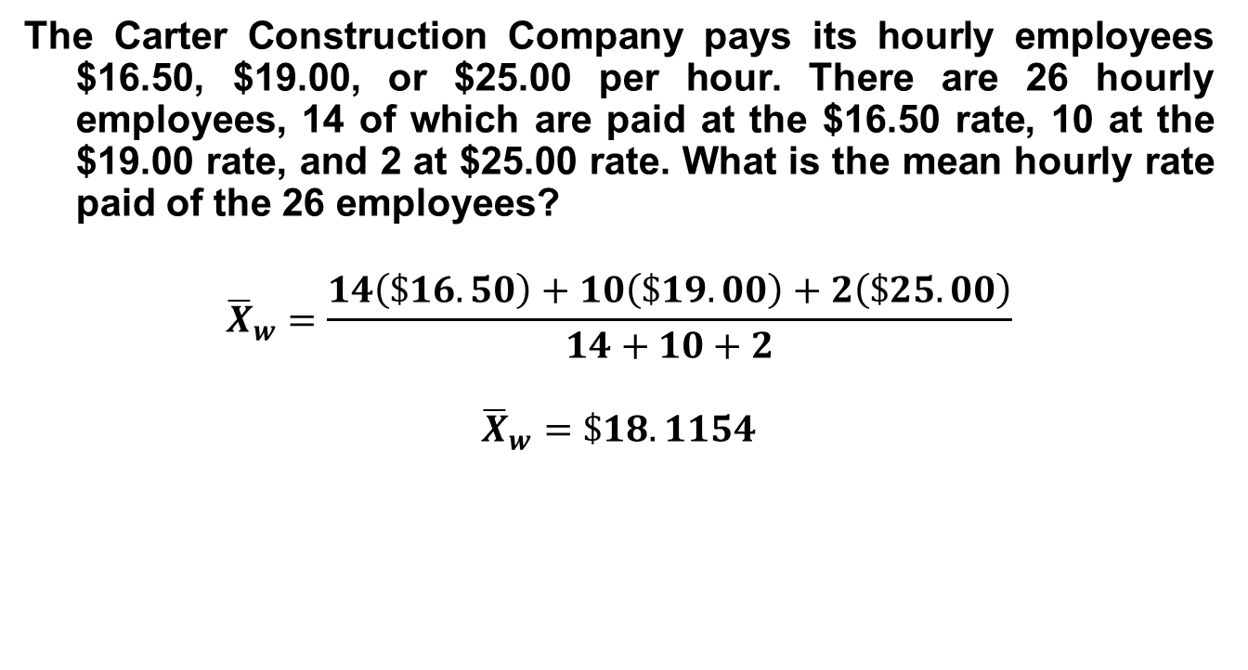
Example of Weighted Mean
The Carter Construction Company pays its hourly employees $16.50, $19.00, or $25.00 per hour. There are 26 hourly employees, 14 of which are paid at the $16.50 rate, 10 at the $19.00 rate, and 2 at $25.00 rate. What is the mean hourly rate paid of the 26 employees?
$${\overline{X}}_{w}=\frac{14\left(\$16.50\right)+10\left(\$19.00\right)+2\left(\$25.00\right)}{14+10+2}$$
$${\overline{X}}_{w}=\$18.1154$$

Slide 8
The Median
The median is the midpoint of the values after they have been ordered from the smallest to largest.
There are as many values above the median as below it in the data array.
For an even set of values, the median will be the arithmetic average of the two middle numbers.

Slide 9
Properties of the Median
There is a unique median for each data set.
It is not affected by extremely large or small values and is therefore a valuable measure of central tendency when such values occur.
It can be computed for ratio-level, interval-level, and ordinal-level data.
It can be computed for an open-ended frequency distribution if the median does not lie in an open-ended class.

Slide 10
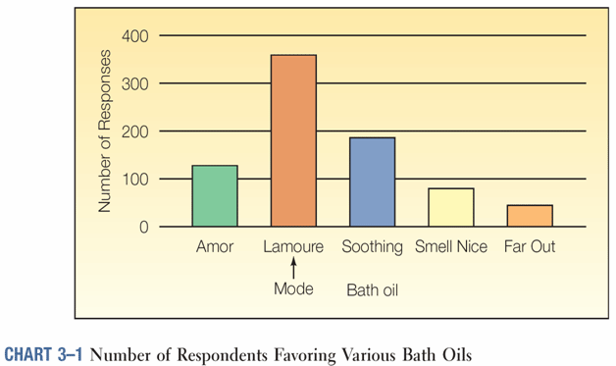
The Mode
The mode is the value of the observation that appears most frequently.

Slide 11
Properties of the Mode
It is used when you want to find the most occurring/frequent score.
It is a quick approximate of the average.
It is an inspection average.
It is the most unreliable among the three measures because its value is undefined in some observations.

Slide 12
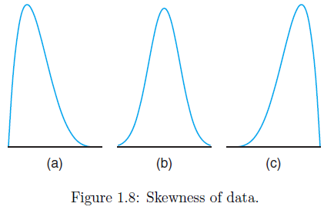
Skewness
A measure of the asymmetry of the frequency distribution
Positive skewness: mode < median < mean
Symmetrical: mode = median = mean
Negative skewness: mode > median > mean

Slide 13
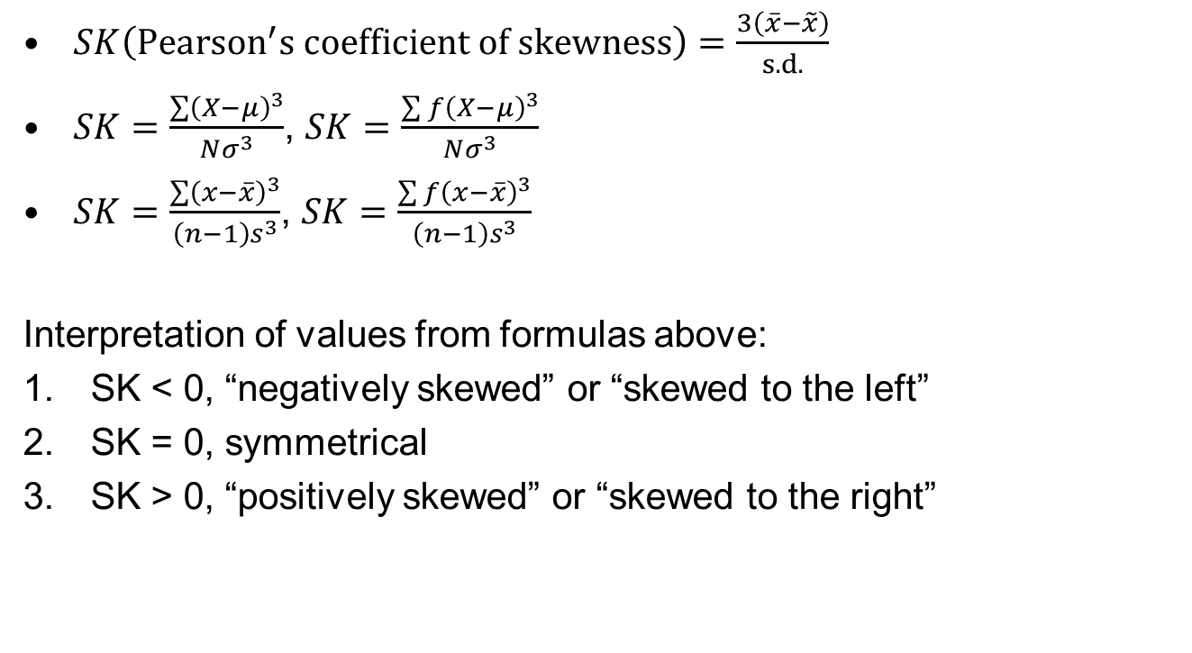
Skewness
$SK\left({Pearson}^{′}s coefficient of skewness\right)=\frac{3\left(\overline{x}−\tilde{x}\right)}{s. d.}$
$SK=\frac{\sum{{\left(X−μ\right)}^{3}}}{Nσ^{3}}$, $SK=\frac{\sum{{f\left(X−μ\right)}^{3}}}{Nσ^{3}}$
$SK=\frac{\sum{{\left(x−\overline{x}\right)}^{3}}}{\left(n−1\right)s^{3}}$, $SK=\frac{\sum{{f\left(x−\overline{x}\right)}^{3}}}{\left(n−1\right)s^{3}}$
Interpretation of values from formulas above:
SK < 0, “negatively skewed” or “skewed to the left”
SK = 0, symmetrical
SK > 0, “positively skewed” or “skewed to the right”

Slide 14
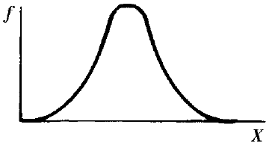
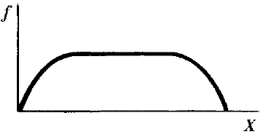
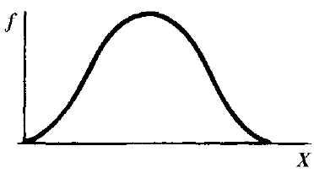
Kurtosis
A measure of the degree to which a unimodal distribution is peaked
The state or quality of flatness or peakedness of the curve describing a frequency distribution about its mode
Leptokurtic
Platykurtic
Mesokurtic

Slide 15

Kurtosis
$K=\frac{\sum{{\left(X−μ\right)}^{4}}}{Nσ^{4}}$, $K=\frac{\sum{f{\left(X−μ\right)}^{4}}}{Nσ^{4}}$
$K=\frac{\sum{{\left(x−\overline{x}\right)}^{4}}}{\left(n−1\right)s^{4}}$, $K=\frac{\sum{f{\left(x−\overline{x}\right)}^{4}}}{\left(n−1\right)s^{4}}$
Interpretation of values from formulas above:
K < 3, “platykurtic”
K = 3, “mesokurtic”
K > 3, “leptokurtic”

Slide 16
Measures of Location
Stem weights in grams of northern red oak seedlings were recorded after the end of 140 days. The data are as follows:
No Nitrogen | Nitrogen
0.32 | 0.26
0.53 | 0.43
0.28 | 0.47
0.37 | 0.49
0.47 | 0.52
0.43 | 0.75
0.36 | 0.79
0.42 | 0.86
0.38 | 0.62
0.43 | 0.46

Slide 17
Measures of Location
Stem weights arranged from lowest to highest:
No Nitrogen | Nitrogen
0.28 | 0.26
0.32 | 0.43
0.36 | 0.46
0.37 | 0.47
0.38 | 0.49
0.42 | 0.52
0.43 | 0.62
0.43 | 0.75
0.47 | 0.79
0.53 | 0.86

Slide 18

Measures of Location
The ◦ values represent the “with nitrogen” data and the × values represent the “without nitrogen” data. Notice that the general appearance of the data might suggest to the reader that, on average, the use of nitrogen increases the stem weight.

Slide 19
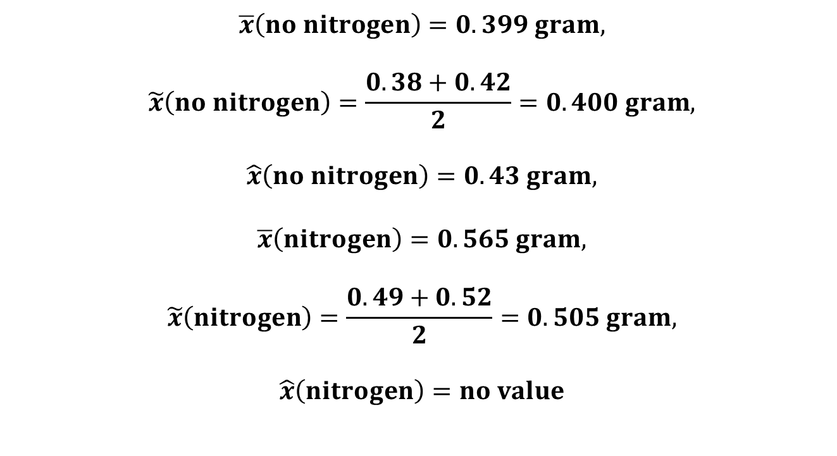
Measures of Location
$$\overline{x}\left(no nitrogen\right)=0.399 gram,$$
$$\tilde{x}\left(no nitrogen\right)=\frac{0.38+0.42}{2}=0.400 gram,$$
$$\hat{x}\left(no nitrogen\right)=0.43 gram,$$
$$\overline{x}\left(nitrogen\right)=0.565 gram,$$
$$\tilde{x}\left(nitrogen\right)=\frac{0.49+0.52}{2}=0.505 gram,$$
$$\hat{x}\left(nitrogen\right)=no value$$

Slide 20
Measures of Location
Quantiles are points taken at regular intervals from the cumulative distribution function of a random variable. Dividing ordered data into q essentially equal-sized data subsets is the motivation for q-quantiles; the quantiles are the data values marking the boundaries between consecutive subsets. There are q − 1 q-quantiles, with k an integer satisfying 0 < k < q.

Slide 21
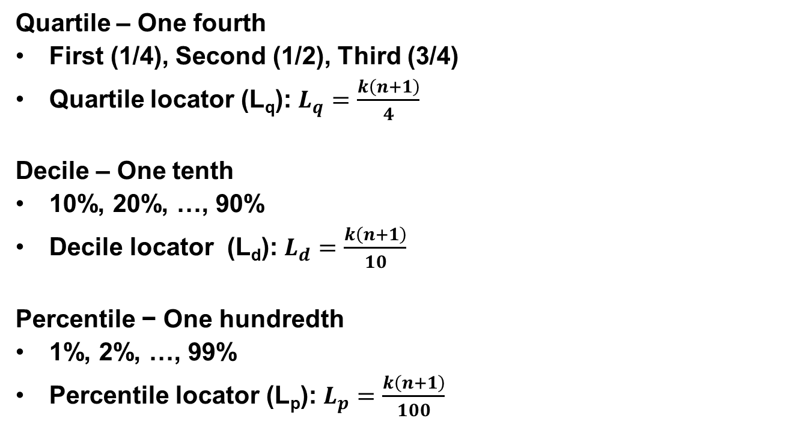
Measures of Location
Quartile – One fourth
First (1/4), Second (1/2), Third (3/4)
Quartile locator (L_{q}): $L_{q}=\frac{k\left(n+1\right)}{4}$
Decile – One tenth
10%, 20%, …, 90%
Decile locator (L_{d}): $L_{d}=\frac{k\left(n+1\right)}{10}$
Percentile − One hundredth
1%, 2%, …, 99%
Percentile locator (L_{p}): $L_{p}=\frac{k\left(n+1\right)}{100}$

Slide 22
Measures of Location
Consider the observations 11, 14, 17, 23, 27, 32, 40, 49, 54, 59, 71, and 80. What is the 29th percentile?
Hint: Solve by interpolation. Refer to examples in Excel file.

Slide 23
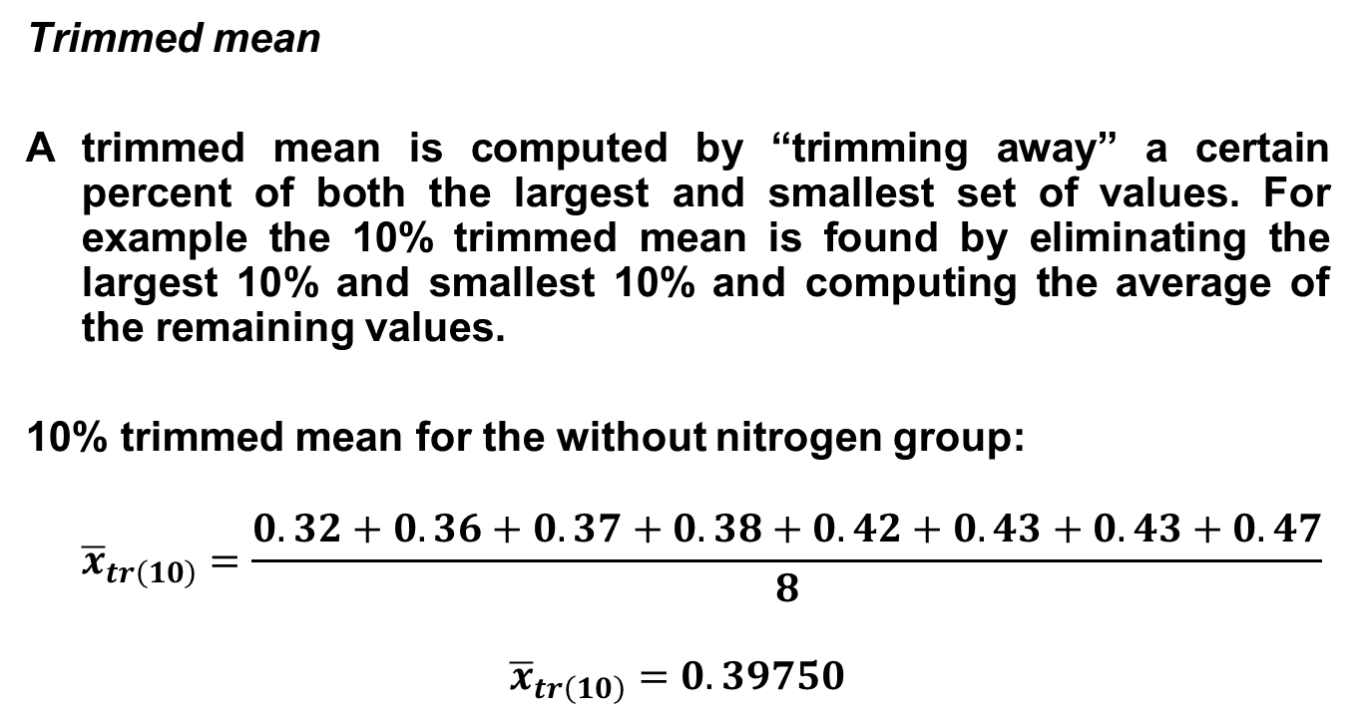
Other Measures of Locations
Trimmed mean
A trimmed mean is computed by “trimming away” a certain percent of both the largest and smallest set of values. For example the 10% trimmed mean is found by eliminating the largest 10% and smallest 10% and computing the average of the remaining values.
10% trimmed mean for the without nitrogen group:
$${\overline{x}}_{tr\left(10\right)}=\frac{0.32+0.36+0.37+0.38+0.42+0.43+0.43+0.47}{8}$$
$${\overline{x}}_{tr\left(10\right)}=0.39750$$

Slide 24

Other Measures of Locations
10% trimmed mean for the with nitrogen group:
$${\overline{x}}_{tr\left(10\right)}=\frac{0.43+0.46+0.47+0.49+0.52+0.62+0.75+0.79}{8}$$
$${\overline{x}}_{tr\left(10\right)}=0.56625$$

Slide 25
Summary
Measures of location | Mean | Median | Mode
Type of data | I, R | I, R, O | N
Extreme score problem | Yes | No | No
Always measurable | Yes | Yes | No
Number of values | 1 | 1 | 0, 1, 2, …
In/out of the set of data | In/out | In/out | In
Characteristics | All scores are taken into account | Middle value | Popular value
I – interval, R – rational, O – ordinal, N – nominal

Slide 26
Dispersion (Measures of Variability)
Why study dispersion?
A measure of location, such as the mean or the median, only describes the center of the data. It is valuable from that standpoint, but it does not tell us anything about the spread of the data.
For example, if your nature guide told you that the river averaged 3 feet in depth, would you want to wade across on foot without additional information? Probably not. You would want to know something about the variation in depth.
A second reason for studying the dispersion in a set of data is to compare the spread in two or more distributions.
These are measures of the average distance of each observation from the center of distribution.
They measure the homogeneity or heterogeneity of a particular group.

Slide 27

Measures of Variability
Range (R)
$$R=H −L$$
Consider the following:
Grades in Statistics
Jon | 100 | Ann | 84
Ron | 65 | Ria | 86
Dan | 75 | Let | 85
Tom | 85 | Bel | 82
Bob | 95 | Nel | 83
Range | 35 | Range | 4

Slide 28
Measures of Variability
Conclusion: Grades of males are more scattered while grades of females are more compressed. Females are more homogeneous in their math ability.
Disadvantages of the range
Unstable for a very large class
Unreliable since only two values are taken into account
Range of two sets of data with unequal number of scores are not directly comparable

Slide 29
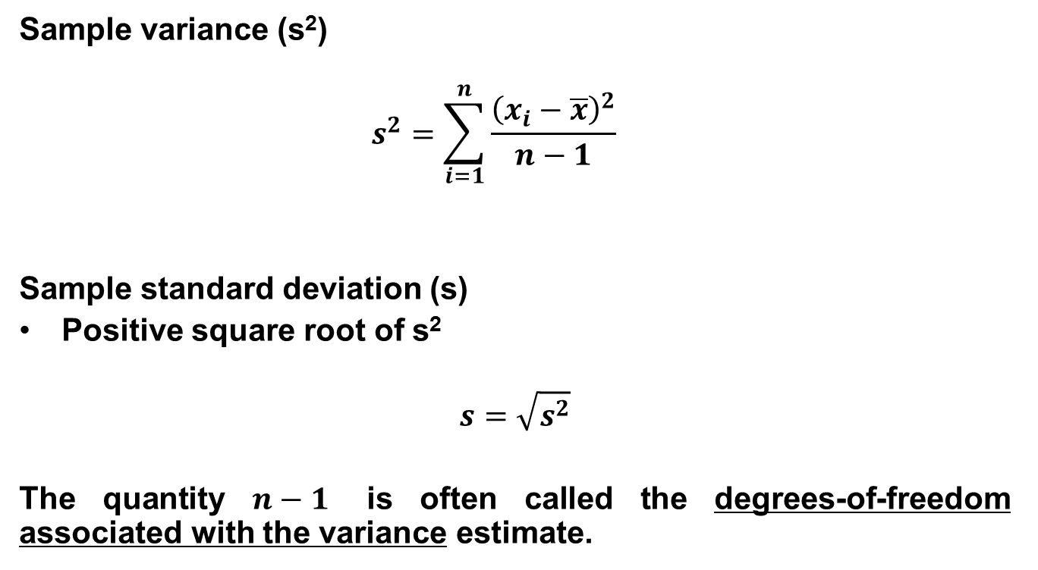
Measures of Variability
Sample variance (s²)
$$s^{2}=\sum_{i=1}^{n}{\frac{{\left(x_{i}−\overline{x}\right)}^{2}}{n−1}}$$
Sample standard deviation (s)
Positive square root of s²
$$s=\sqrt{s^{2}}$$
The quantity $n−1$ is often called the degrees-of-freedom associated with the variance estimate.

Slide 30

Measures of Variability
Population variance (σ²)
$$σ^{2}=\sum_{i=1}^{n}{\frac{{\left(X_{i}−μ\right)}^{2}}{N}}$$
Population standard deviation (σ)
Positive square root of σ²
$$σ=\sqrt{σ^{2}}$$

Slide 31
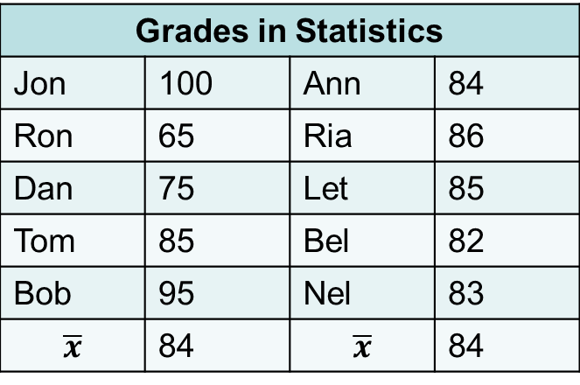
Measures of Variability
Example: Determine the variance in the previous example treating the data as a population and sample.
Grades in Statistics
Jon | 100 | Ann | 84
Ron | 65 | Ria | 86
Dan | 75 | Let | 85
Tom | 85 | Bel | 82
Bob | 95 | Nel | 83
$$\overline{x}$$ | 84 | $$\overline{x}$$ | 84

Slide 32
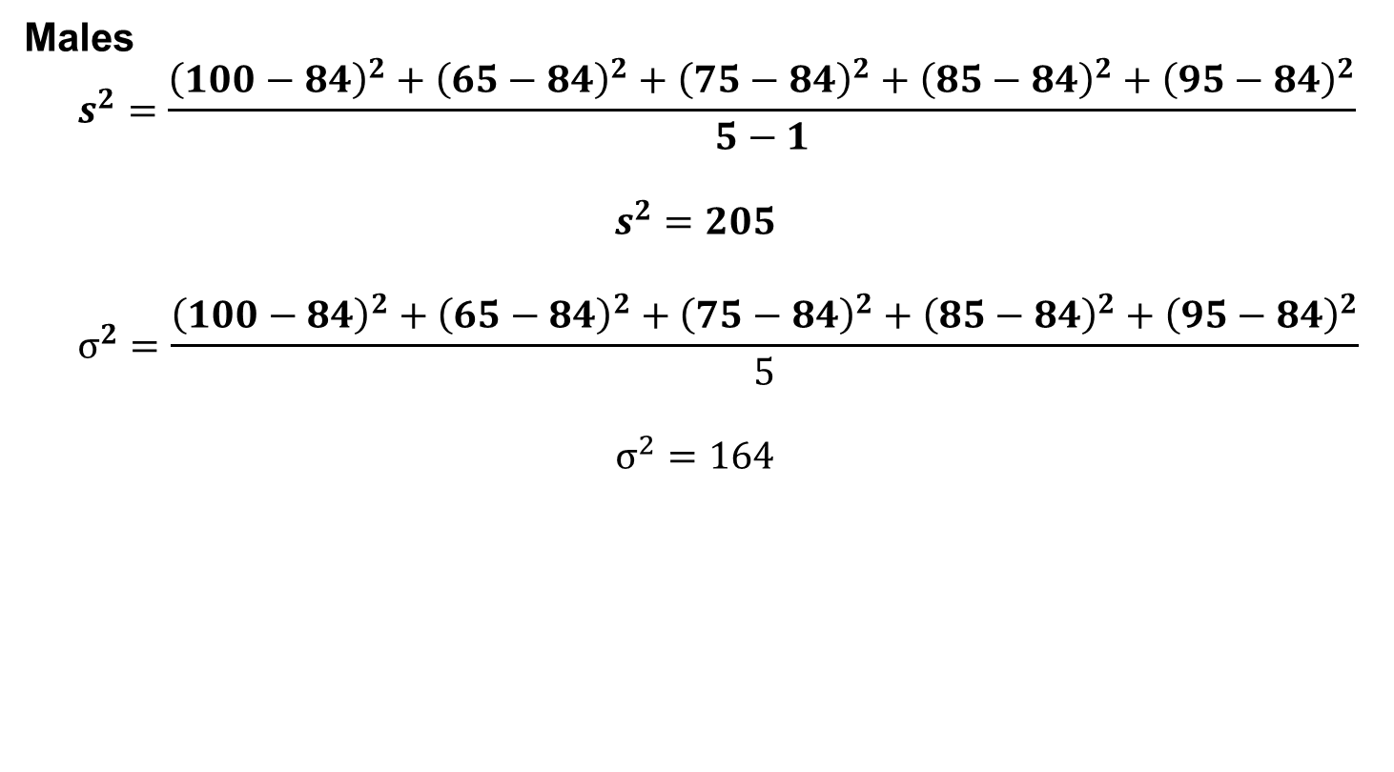
Measures of Variability
Males
$$s^{2}=\frac{{\left(100−84\right)}^{2}+{\left(65−84\right)}^{2}+{\left(75−84\right)}^{2}+{\left(85−84\right)}^{2}+{\left(95−84\right)}^{2}}{5−1}$$
$$s^{2}=205$$
$$σ^{2}=\frac{{\left(100−84\right)}^{2}+{\left(65−84\right)}^{2}+{\left(75−84\right)}^{2}+{\left(85−84\right)}^{2}+{\left(95−84\right)}^{2}}{5}$$
$$σ^{2}=164$$

Slide 33
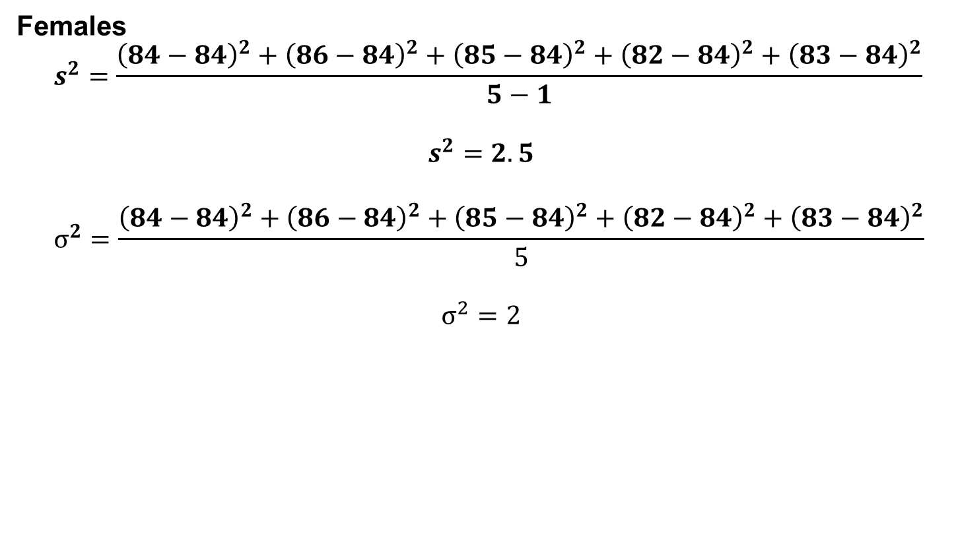
Measures of Variability
Females
$$s^{2}=\frac{{\left(84−84\right)}^{2}+{\left(86−84\right)}^{2}+{\left(85−84\right)}^{2}+{\left(82−84\right)}^{2}+{\left(83−84\right)}^{2}}{5−1}$$
$$s^{2}=2.5$$
$$σ^{2}=\frac{{\left(84−84\right)}^{2}+{\left(86−84\right)}^{2}+{\left(85−84\right)}^{2}+{\left(82−84\right)}^{2}+{\left(83−84\right)}^{2}}{5}$$
$$σ^{2}=2$$

Slide 34
Measures of Variability
Conclusion: Males showed more variability. The higher the variance, the more variable or far apart the values are from each other.
Remark: Since the variance is in squared units, it does not reflect the true meaning of data being measured.

Slide 35

Measures of Variability
Males
$$s=14.3178$$
$$σ=12.8062$$
Females
$$s=1.5811$$
$$σ=1.4142$$

Slide 36
Measures of Variability
Example:
Consider the following test scores:
Who performed better?
Who is more consistent?
Test | 1 | 2 | 3 | 4 | 5 | 6 | 7 | 8 | 9 | 10
Student A | 12 | 6 | 13 | 2 | 5 | 0 | 9 | 6 | 10 | 7
Student B | 8 | 10 | 9 | 12 | 5 | 1 | 4 | 7 | 9 | 3

Slide 37
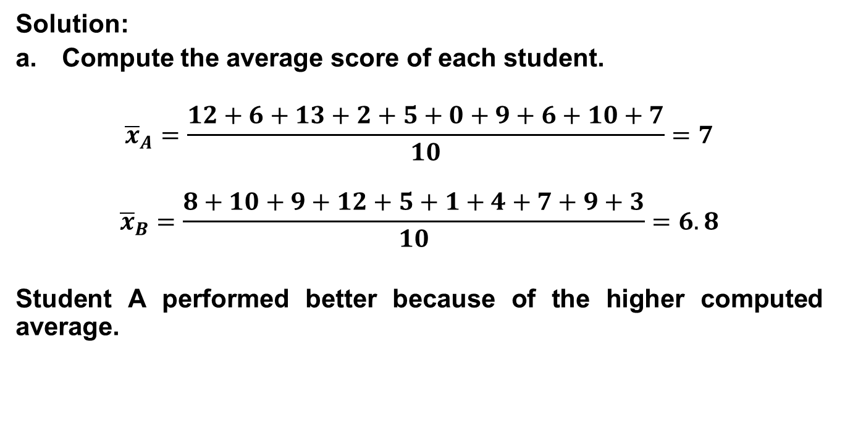
Measures of Variability
Solution:
Compute the average score of each student.
$${\overline{x}}_{A}=\frac{12+6+13+2+5+0+9+6+10+7}{10}=7$$
$${\overline{x}}_{B}=\frac{8+10+9+12+5+1+4+7+9+3}{10}=6.8$$
Student A performed better because of the higher computed average.

Slide 38
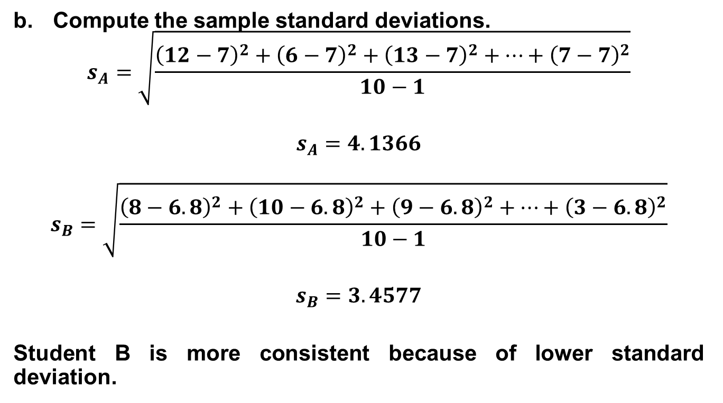
Measures of Variability
Compute the sample standard deviations.
$$s_{A}=\sqrt{\frac{{\left(12−7\right)}^{2}+{\left(6−7\right)}^{2}+{\left(13−7\right)}^{2}+…+{\left(7−7\right)}^{2}}{10−1}}$$
$$s_{A}=4.1366$$
$$s_{B}=\sqrt{\frac{{\left(8−6.8\right)}^{2}+{\left(10−6.8\right)}^{2}+{\left(9−6.8\right)}^{2}+…+{\left(3−6.8\right)}^{2}}{10−1}}$$
$$s_{B}=3.4577$$
Student B is more consistent because of lower standard deviation.

Slide 39
Measures of Variability
Remark: Standard deviation and variance are both reliable but cannot be used in comparing two sets of data of different units.
Example: Consistency of a player − assist or making points

Slide 40
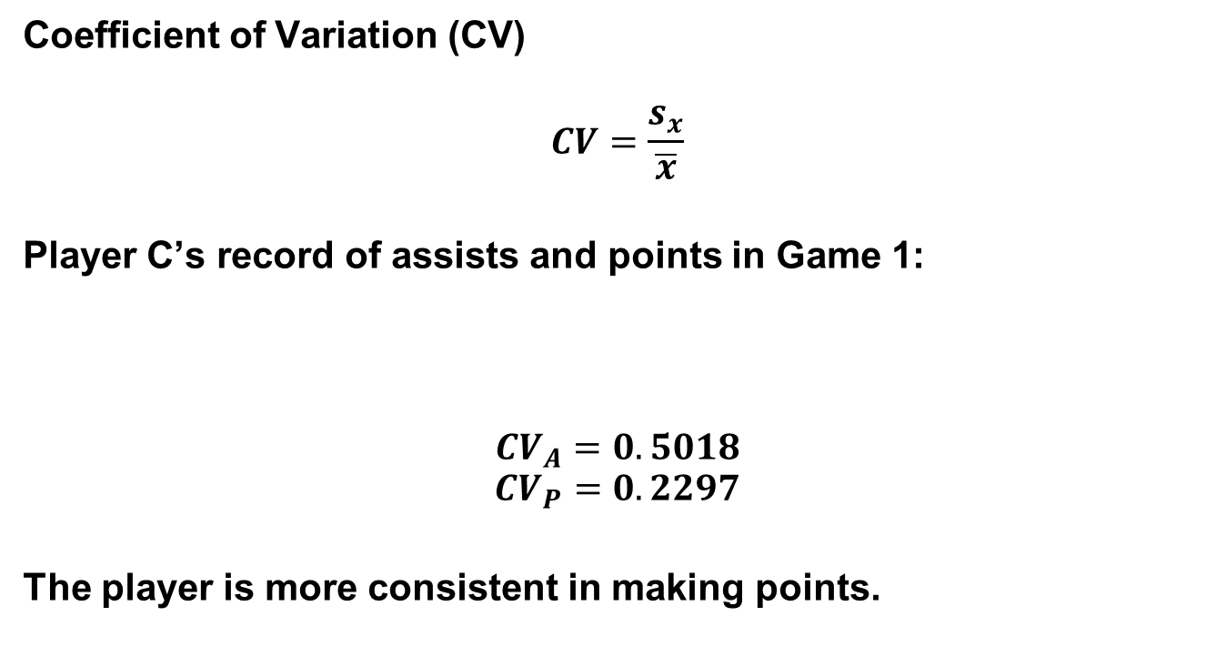
Measures of Variability
Coefficient of Variation (CV)
$$CV=\frac{s_{x}}{\overline{x}}$$
Player C’s record of assists and points in Game 1:
$${CV}_{A}=0.5018$$
$${CV}_{P}=0.2297$$
The player is more consistent in making points.
A | 7 | 10 | 9 | 1 | 5 | 3 | 4 | 7 | 9 | 4
P | 25 | 25 | 30 | 22 | 23 | 22 | 16 | 35 | 20

Slide 41

Measures of Variability
Mean deviation (MD)
$$MD=\frac{\sum_{i=1}^{n}{\left|x_{i}−\overline{x}\right|}}{n}$$

Slide 42

Measures of Location (Grouped Data)
$$\overline{x}=\frac{\sum{fx}}{n}$$
$$\tilde{x}=x_{lcb}+\left(\frac{\frac{n}{2}−<cf}{f_{\tilde{x}}}\right)c$$
$$\hat{x}=x_{lcb}+\left(\frac{d_{1}}{d_{1}+d_{2}}\right)c$$

Slide 43
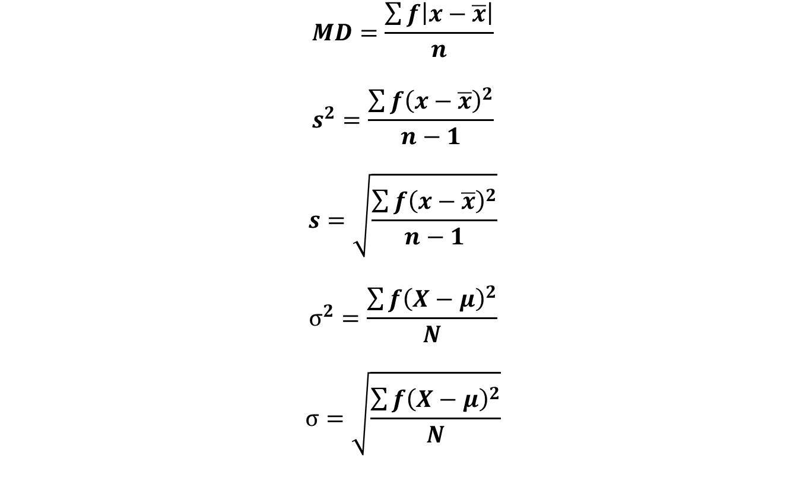
Measures of Variability (Grouped Data)
$$MD=\frac{\sum{f\left|x−\overline{x}\right|}}{n}$$
$$s^{2}=\frac{\sum{f{\left(x−\overline{x}\right)}^{2}}}{n−1}$$
$$s=\sqrt{\frac{\sum{f{\left(x−\overline{x}\right)}^{2}}}{n−1}}$$
$$σ^{2}=\frac{\sum{f{\left(X−μ\right)}^{2}}}{N}$$
$$σ=\sqrt{\frac{\sum{f{\left(X−μ\right)}^{2}}}{N}}$$

Slide 44
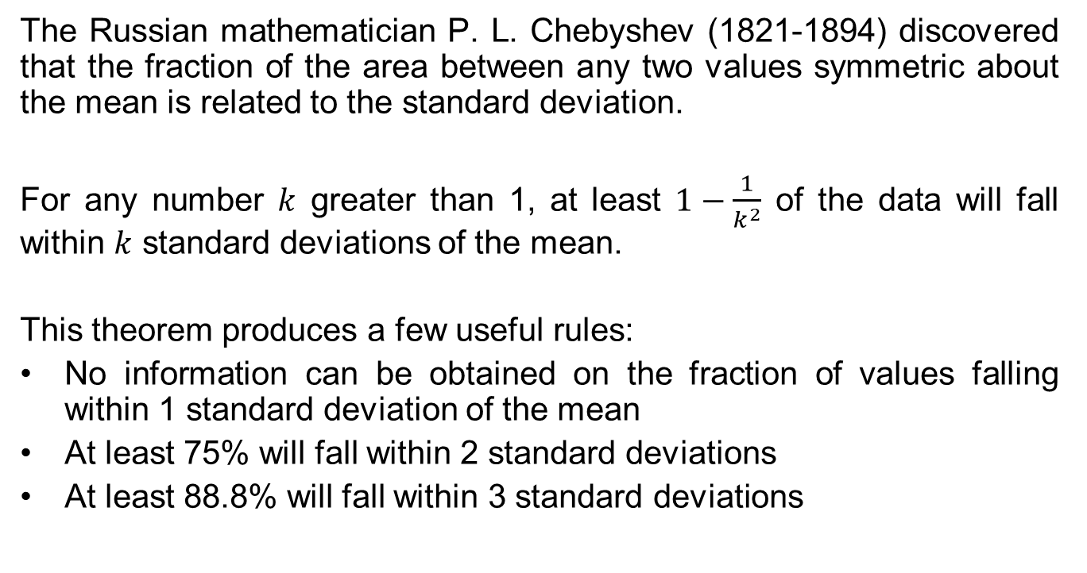
Chebyshev’s Theorem
The Russian mathematician P. L. Chebyshev (1821-1894) discovered that the fraction of the area between any two values symmetric about the mean is related to the standard deviation.
For any number $k$ greater than 1, at least $1−\frac{1}{k^{2}}$ of the data will fall within $k$ standard deviations of the mean.
This theorem produces a few useful rules:
No information can be obtained on the fraction of values falling within 1 standard deviation of the mean
At least 75% will fall within 2 standard deviations
At least 88.8% will fall within 3 standard deviations

Slide 45
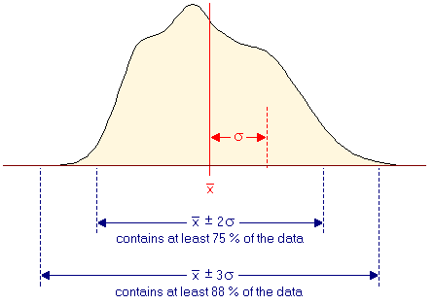
Chebyshev’s Theorem
The following figure is a graphical representation of the rules.

Slide 46
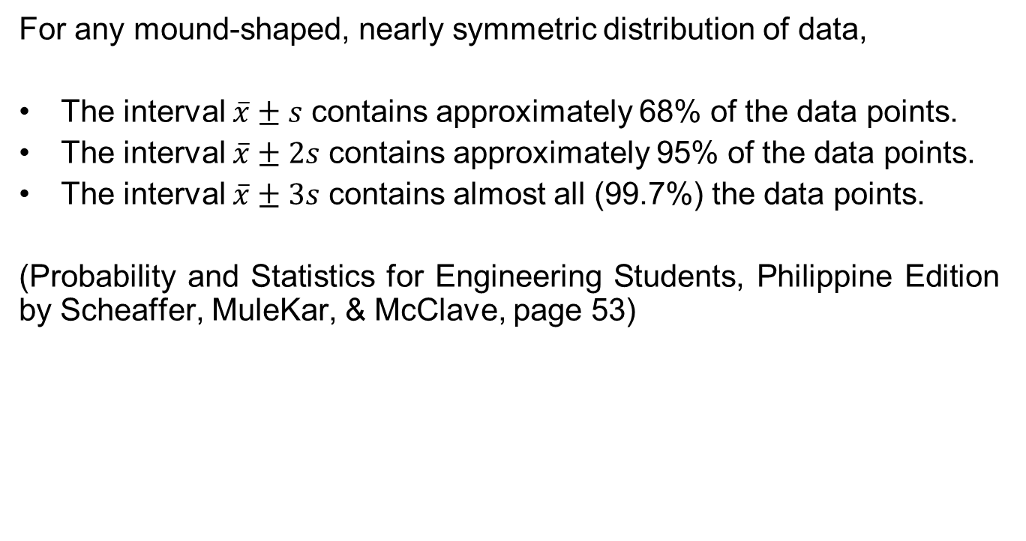
Empirical Rule
For any mound-shaped, nearly symmetric distribution of data,
The interval $\overline{x}±s$ contains approximately 68% of the data points.
The interval $\overline{x}±2s$ contains approximately 95% of the data points.
The interval $\overline{x}±3s$ contains almost all (99.7%) the data points.
(Probability and Statistics for Engineering Students, Philippine Edition by Scheaffer, MuleKar, & McClave, page 53)

